Slide 2
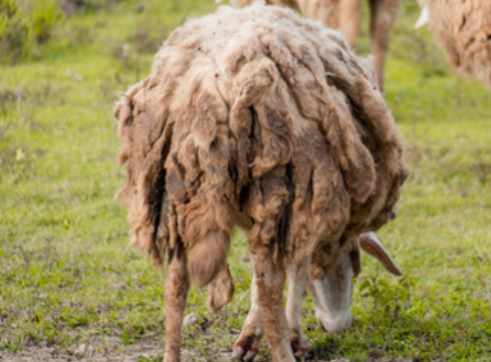
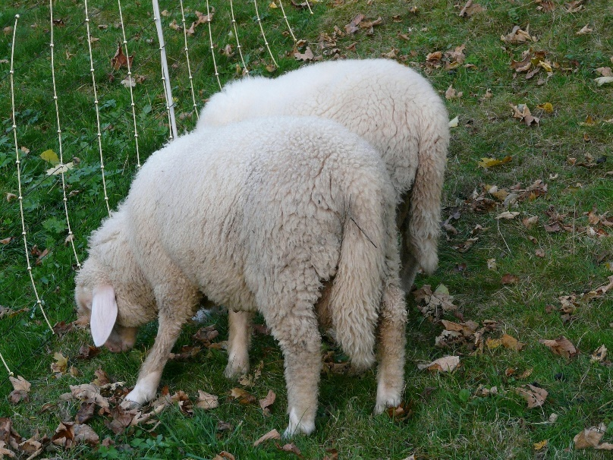
Sheep Tails
Most sheep in the UK have long tails
Long tails become dirty and attract flies
Lambs’ long tails are ‘docked’
This shortens the tails and prevents them becoming as dirty
It has a naturally short tail
Copyright © 2019 All rights reserved by The University of Edinburgh
This is a Bighorn Sheep
Notes:
Sheep are farmed, in part, for wool. Species that produce good quality wool usually have long tails. Long tails can get very dirty (top left picture). Dirty, matted tails are targets for disease as flies lay their eggs in them.
To prevent disease farmers will ‘dock’ lambs tails (top middle picture) to shorten them (top right picture). This is done by various methods and while everything is done to limit pain, docking is an uncomfortable procedure for lambs.
Some sheep however do not have long tails. An example are Bighorn Sheep (bottom picture) that have very short tails. These sheep breeds do not need their tails docked.
There are however no known sheep breeds that have no tail.
It would be an advantage to farmers to have sheep that produce good meat and fleeces, and also have short tails. This would improve sheep welfare as it would greatly reduce the risk of fly strike, and remove the need to dock lambs’ tails.

Slide 3
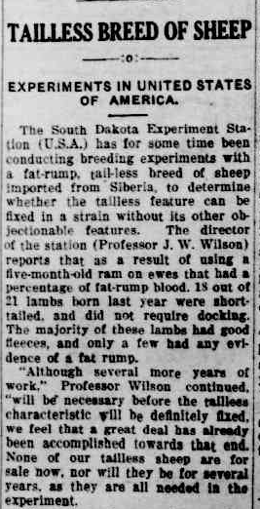
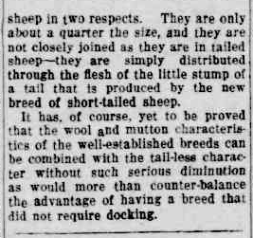
Selective Breeding - 1927
Copyright © 2019 All rights reserved by The University of Edinburgh
Notes:
In South Dakota (USA) in 1927 there was an experiment done that aimed to breed sheep with both a fat-rump tail (no docking) and a good quality fleece.
This experiment involved breeding a long-tailed ram with ewes that had fat-rump ancestry. Out of the 21 lambs born, 15 of them had short tails and did not need docking. Most of these lambs also had good quality fleeces, and only a few of them had a fat rump. What was not seen however were tailless sheep.
As this was a fairly long time ago, selective breeding could only be done by looking at the phenotype.

Slide 4
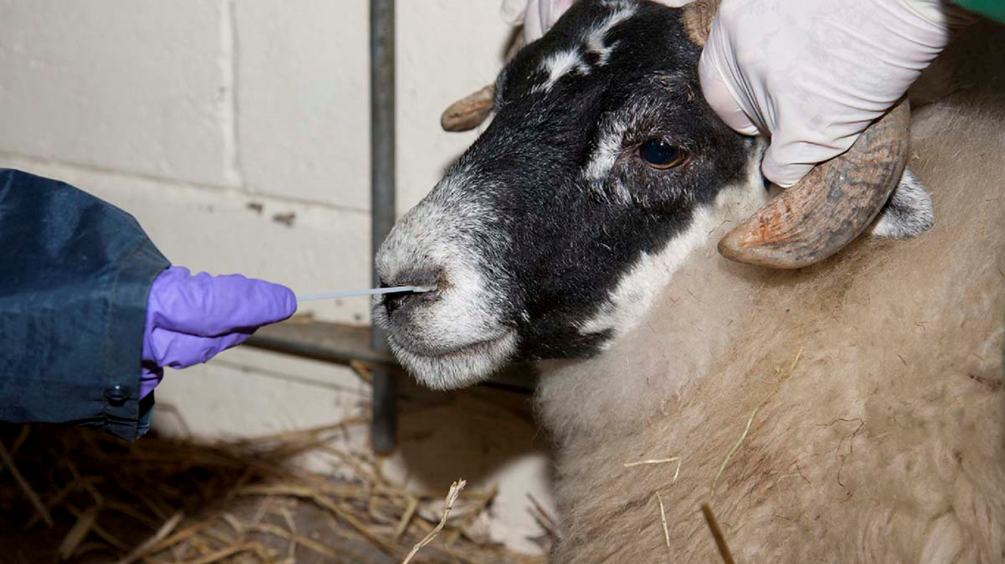
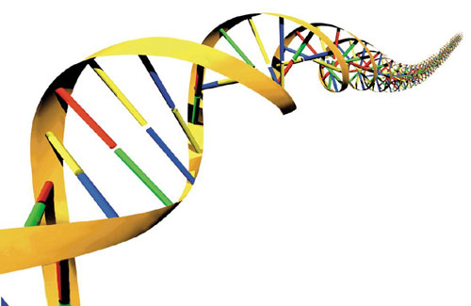
What to do next?
Copyright © 2019 All rights reserved by The University of Edinburgh
Notes:
Nowadays we can look at the DNA.
We can collect DNA from a sheep by doing a nasal swab.
We have collected DNA from 7 sheep. We know the genotype of 3 of these sheep. You are going to find out the genotype of the other 4.

Slide 5
Tailless Gene
PCR
long tail
t
T
short tail
t
Copyright © 2019 All rights reserved by The University of Edinburgh
Notes:
The gene thought to be responsible for the tailless phenotype has two alleles.
t is the allele for long tails, which is the most common.
T is the allele for short tails and due to a deletion in the middle of the gene, is shorter than the long tail allele.
In order to find out the genotypes of our unknown sheep we will first need more copies of the DNA. For this we will use PCR.

Slide 6
What are the ingredients for PCR?
Copyright © 2019 All rights reserved by The University of Edinburgh
Notes:
Give out whiteboards to each group.

Slide 7
How does PCR work?
What are these?
Uses repetitive cycles of heating a cooling to make many copies of the DNA strands
Forward
Forward
Reverse
Reverse
Primers
t
t
Which allele gives the biggest PCR product?
T
T
t
Copyright © 2019 All rights reserved by The University of Edinburgh
Notes:
PCR is often used to amplify genomic DNA samples.
Some of the uses of PCR include:
Amplifying regions of DNA
Screening for the presence or absence of a specific sequence, often used for disease diagnosis.
Generating genetic profiles for use in paternity disputes or to identify suspects from crime scenes.
We can use the same primers for both alleles as the DNA sequence at the ends of the gene are the same

Slide 8
Gel Electrophoresis - to separate different sizes of DNA
- Negative electrode
Larger DNA fragments move slower
Molecules of the same size travel the same distance and form a band
Smaller DNA fragments move faster
Agarose gel
+ Positive electrode
Copyright © 2019 All rights reserved by The University of Edinburgh
Notes:
Electrophoresis involves loading the DNA samples onto a gel. Look at the electrophoresis rigs in front of you, and the the slabs of gel inside. There are rows of little wells on the gels where the DNA will be loaded. After we load the DNA, we apply an electric current across the gel, creating a negative and positive pole.
Show animation on slide
Because DNA molecules are negatively charged, the DNA moves from the negative pole to the positive pole. Larger DNA fragments lag behind and smaller DNA fragments migrate further.
From each well, we obtain a pattern of separated DNA fragments. The DNA has been separated on the basis of size.

Slide 9
Loading our samples onto an agarose gel
Hold pipette tip just above well, below buffer level
Buffer
Be careful not to pierce the bottom of the well with the pipette tip!
Agarose gel
What DNA samples do we have to load?
Copyright © 2019 All rights reserved by The University of Edinburgh
Notes:
When you load the gels, you will get more control if you place your elbow on the bench, and support your pipette arm with your other arm. You also must be careful not to go too far and pierce the bottom of the wells with the pipette tip. Hold the pipette tip just below the level of the buffer in the tank. Once you’ve pipetted the sample into the well, keep your thumb on the plunger until you’ve removed the tip from the well – otherwise you’ll suck the sample back up.
Give a selection of pupils the opportunity to load the samples, or demonstrate this step.

Slide 10
Gel loading plan
N
C
A
S1
S2
S3
S4
Key
N – is a long tailed sheep we know has only the long tail allele
C – is a carrier, who has one copy of the long tail allele and one copy of the short tail allele
A – is affected, this sheep only has the short tail allele
S1-S4 – are unknown
10μl
10μl
10μl
10μl
10μl
10μl
10μl
Gel
Copyright © 2019 All rights reserved by The University of Edinburgh
Notes:
We have given you 7 DNA samples.
N – is a long tailed sheep we know has only the long tail allele
C – is a carrier, who has one copy of the long tail allele and one copy of the short tail allele.
A – is affected, this sheep only has the short tail allele
S1-S4 – are unknown. You are going to figure out the genotype of these sheep, by comparing the gel results to the 3 known sheep.

Slide 11
Health and Safety – For Teachers
Pupils are NOT permitted to turn on or turn off the power pack, or touch the equipment while running.
Make sure the lid is on properly (pushed down fully) before the power pack is turned on
Run at 120V, 70A for ~25-30 minutes if using chilled buffer, or at 90V for 30-35 minutes if using room temperature buffer.
DO NOT open the lid when the power is on
After the gel has been run, stop the power pack then turn it off at the back and the wall before removing the lid of the gel tank
Copyright © 2019 All rights reserved by The University of Edinburgh

Slide 12
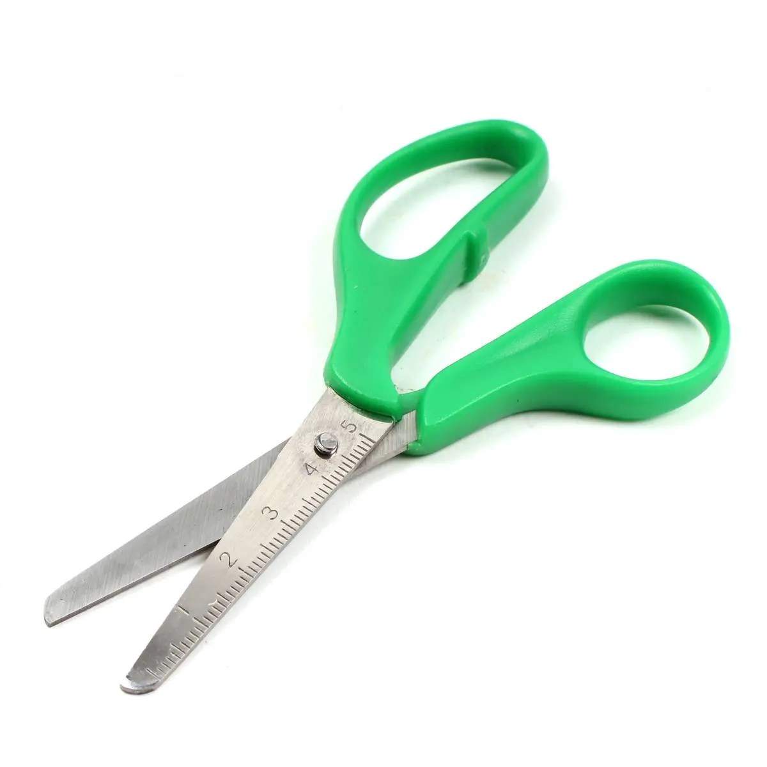
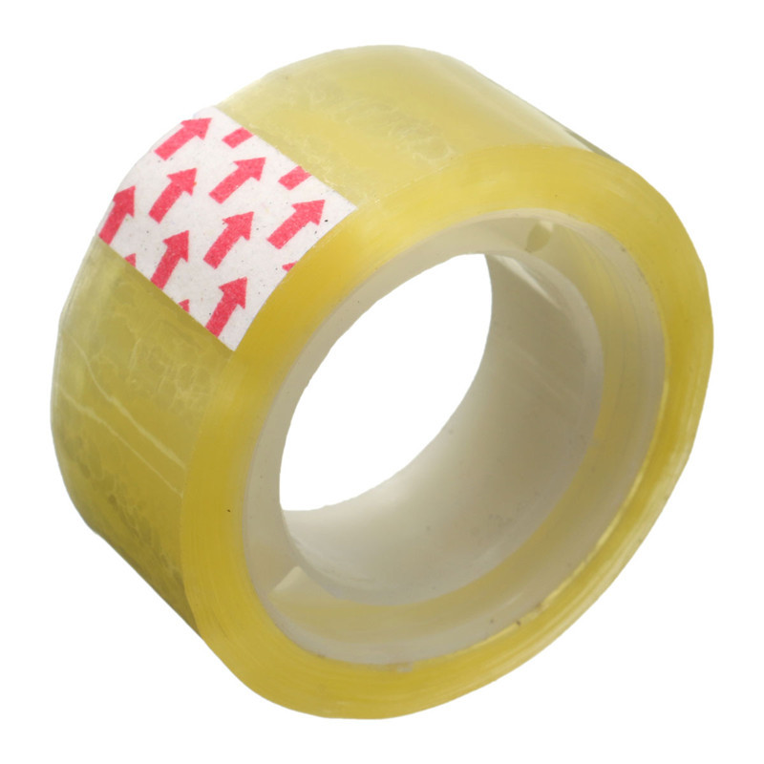
Recreate the PCR reaction
DNA
primers
nucleotides
Scissors and sticky tape is also required.
Copyright © 2019 All rights reserved by The University of Edinburgh
Notes:
Download the PCR activity from the EBSOC website, print off the sequences, primers and nucleotides
Carry out the paper PCR activity while the gel is running
Working in groups of 4 students, they carry out three rounds of PCR.
Separate DNA strands using the scissors
Primers bind their complementary sequences
DNA polymerase extends 5’ – 3’- pupils add nucleotides in the correct direction and use sticky tape to form the bonds
Repeat 3 more times to get the target PCR product
Encourage the pupils to talk through the cycle as they go, listing the temperatures.

Slide 13
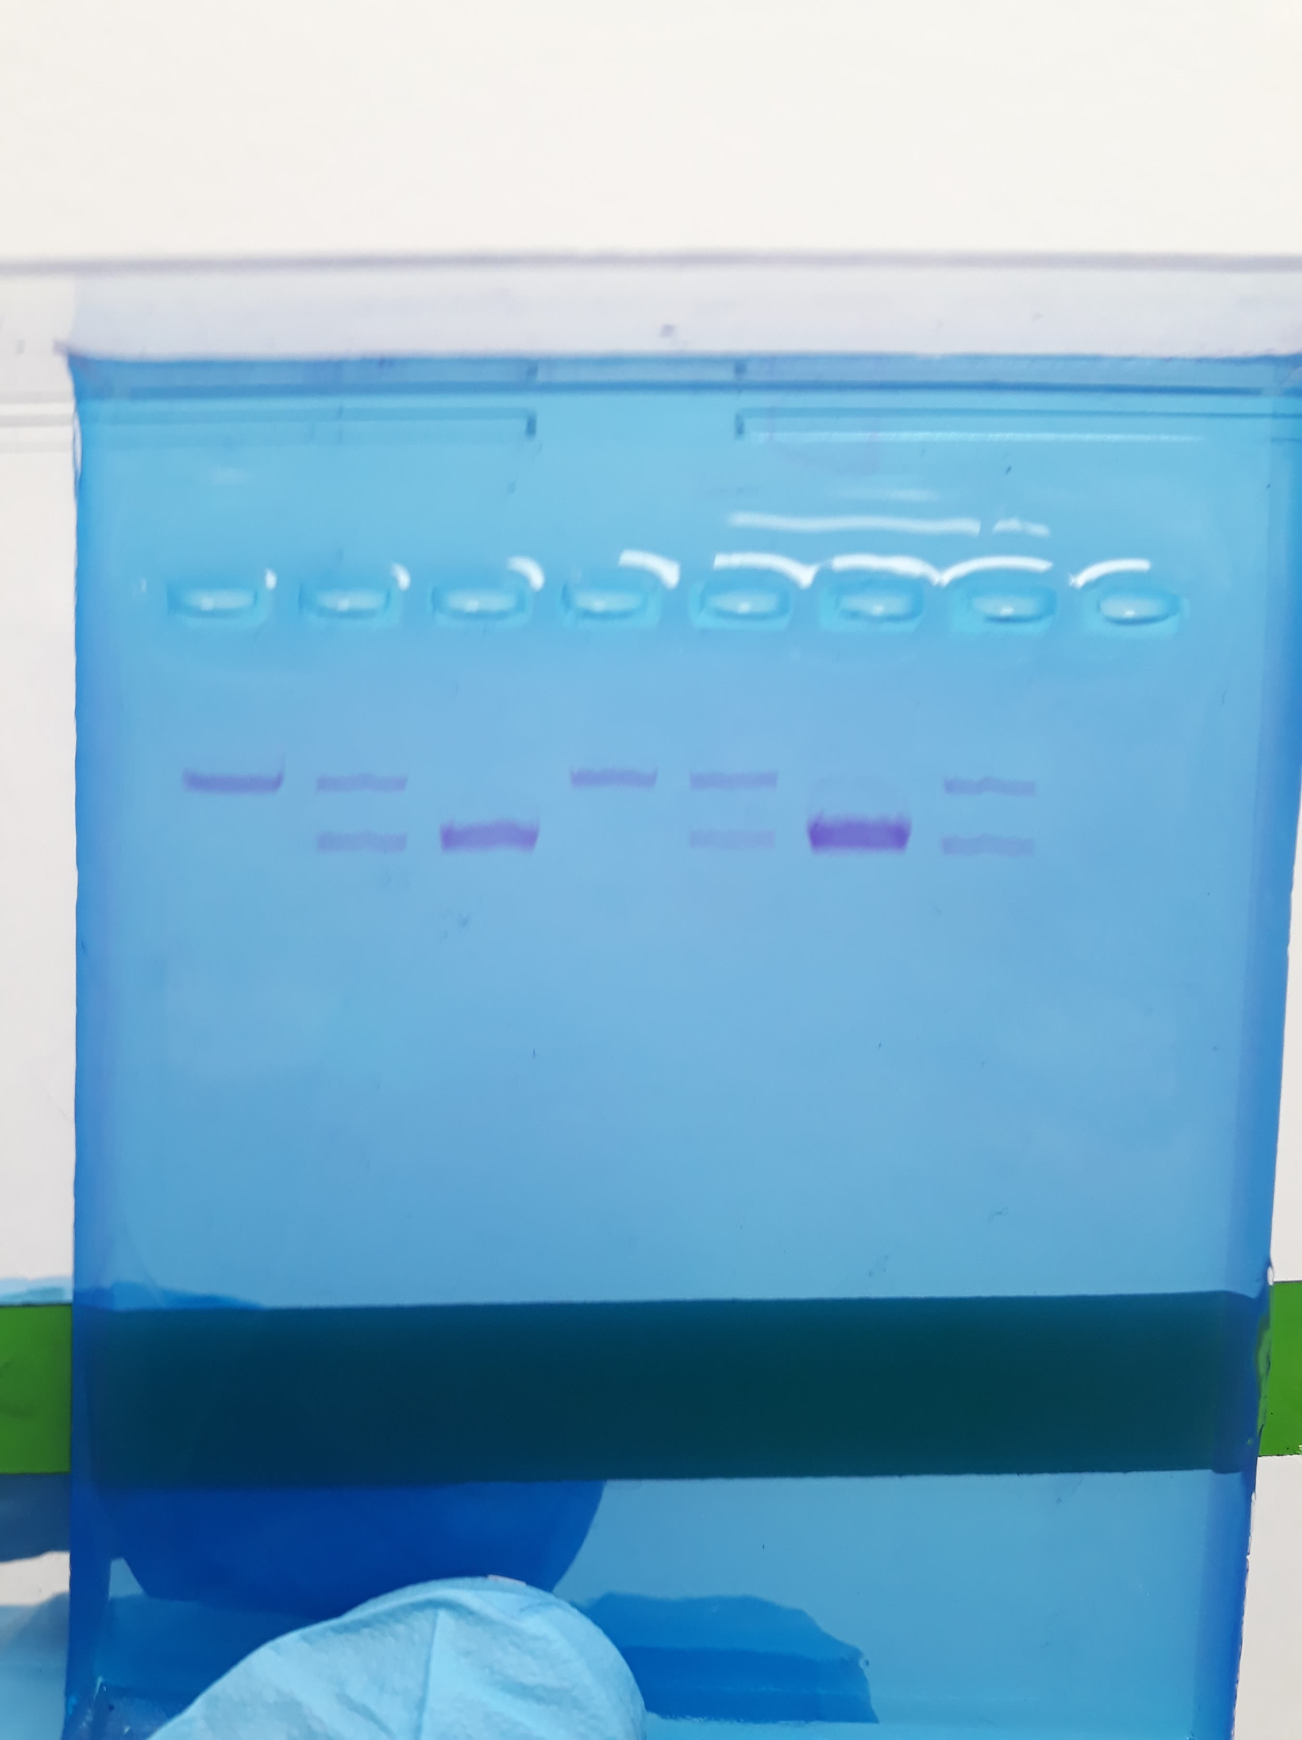
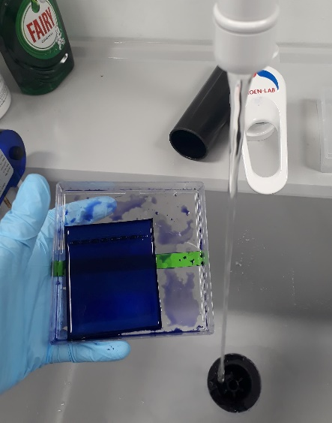
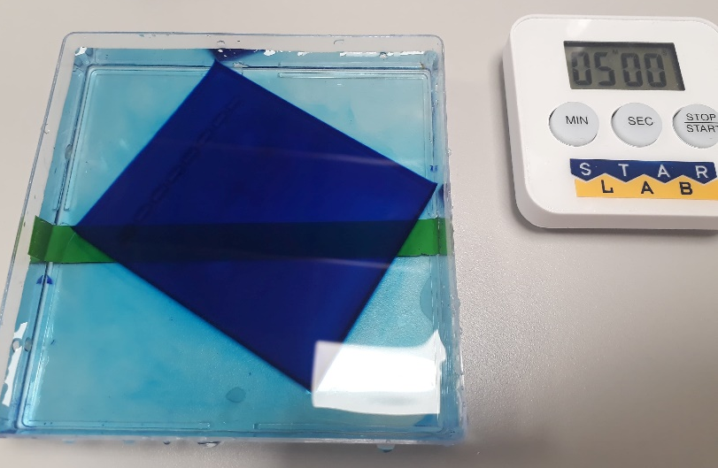
Fast Blast DNA Stain – 15 minutes
Pour 50ml of 100x DNA Stain onto the gel
Leave for 3 minutes
Pour off the stain (keep, as it can be reused)
Rinse the gel with warm water for ~10 seconds
Wash the gel with warm water for 5 minutes
Wash the gel again for 5 minutes
Copyright © 2019 All rights reserved by The University of Edinburgh
Notes:
More detailed instructions for the fast blast staining can be found in the instruction guide, including the instructions for overnight staining.

Slide 14
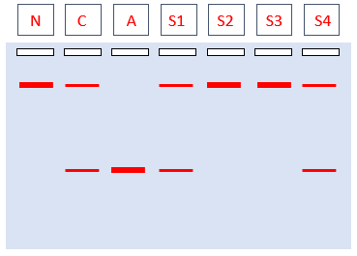
DNA Analysis
Copyright © 2019 All rights reserved by The University of Edinburgh
Notes:
This is what students should see

Slide 15
Pedigree Analysis
?
?
F0:
N
C
A
?
T = Short Tail
t = Long Tail
tt
?
Tt
= Male
?
?
TT
Tt
?
?
?
F1:
tt
tt
Tt
= Female
S1 | S2 | S3 | S4
Use the results from your gel to add the genotype of each sheep to the pedigree
Copyright © 2019 All rights reserved by The University of Edinburgh

Slide 16
Pedigree Analysis
Tt
Tt
Tt
tt
tt
Tt
?
F0:
?
N
C
A
tt
Tt
TT
Tt
tt
tt
Tt
F1:
S1 | S2 | S3 | S4
1) Which sheep are tailless?
2) What are the possible genotypes of the parents (F0)?
Copyright © 2019 All rights reserved by The University of Edinburgh
Notes:
None of the sheep are tailless.
As none of the 4 unknowns are TT. It is possible that the parents could be Tt/Tt or Tt/tt. As there is no evidence that taillessness is sex linked either parent could be Tt or tt.
T t t t
T TT Tt T Tt Tt
t Tt tt t tt tt
TT : 25% TT : 0%
Tt : 50% Tt : 50%
tt : 25% tt : 50%
See the punnett squares above for the probabilities of each genotype. Our sheep follow the probabilities for the second punnett square. Does this mean that Tt / tt are the correct genotypes for the parents?
- We have only tested 4 sheep, which is not enough to be sure. We would need to either test more offspring of these to parents, or test the parents themselves.

Slide 17
Why are there no homozygous dominant sheep?
Tt
tt
Tt
Tt
tt
Tt
We have only tested 4 sheep, which may not be enough to see all genotypes
Having two dominant alleles is lethal
Only one parent has a dominant allele
Other explanations?
Copyright © 2019 All rights reserved by The University of Edinburgh

Slide 18
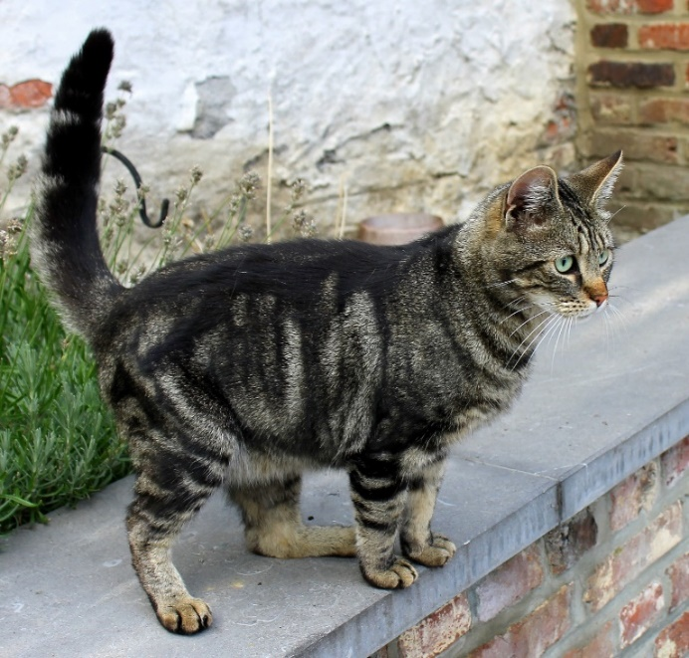
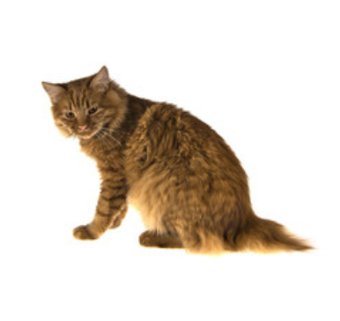
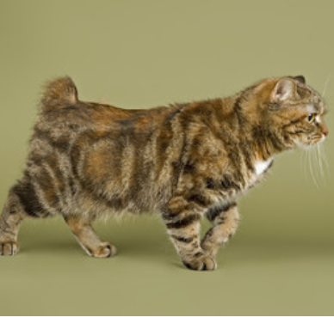
Manx Cat
Longy | Stubby | Riser | Rumpy
Copyright © 2019 All rights reserved by The University of Edinburgh
Notes:
These are Manx cats, who are known for being tailless. The characteristic is also caused by a single gene mutation where the short tail gene is dominant to the long tail allele.
All Manx cats with shortened or no tails are heterozygous. There are a range of intermediate phenotypes for the heterozygotes (shown above).
It has been proven in manx cats that the homozygous dominant genotype is fatal early in development. The mutation causes shortening of the spine, and if there are two copies this shortening is too severe.
In manx cats the gene responsible for this has been characterised. The mutation occurs in the T gene which codes for brachyury. The mutation is a deletion which causes a frameshift and introduces a premature stop codon. This results in a shortened, non-functional protein.

Slide 19
This classroom resource has been developed by the
Easter Bush Science Outreach Centre
To download a digital copy of this booklet for printing visit www.ebsoc.ed.ac.uk
Tweet us your science investigation @EBSOClab #GelElectrophoresis
Copyright © 2019 All rights reserved by The University of Edinburgh

