Slide 1
Notes:
EBSOC, based in Midlothian and Easter Bush has is a science lab for kids to do real- science. They have sent us a science kits so that we can do some real science here in our classroom as part of the Great Science Share!

Slide 2
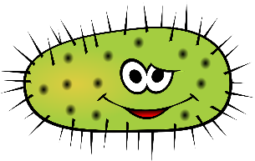
The Great Science Share

Slide 3
You are part of Edinburgh’s GSS Satellite!
Notes:
The Great Science Share is an exciting project that we are now a part of!

Slide 4
What is the Great Science Share?
Notes:
Play video.

Slide 5
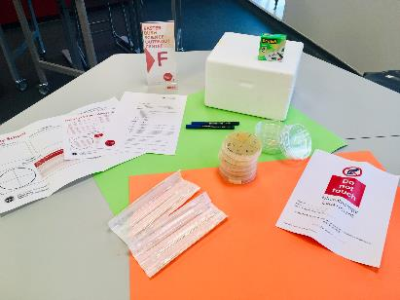
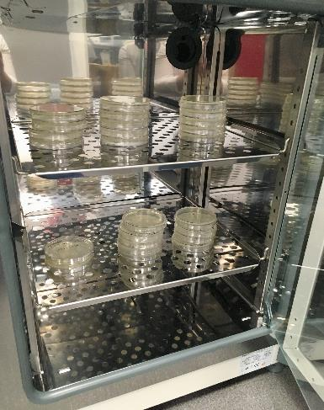
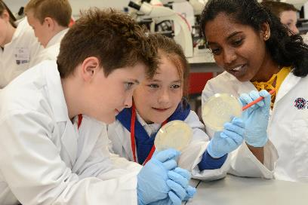
What are we going to do?
Using a science kit that we have been sent from the Easter Bush Science Outreach Centre, you are going to design and do an experiment.
What do you want to know about microorganisms?
@EBSOClab #MicrobeToolkit
Notes:
Introduction to what they are going to do.

Slide 6
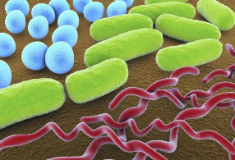
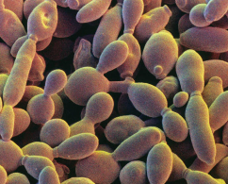
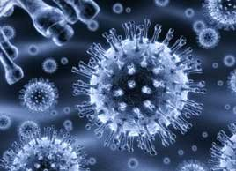
What are microorganisms?
microorganism
tiny
a living thing
Bacteria
Fungi
Viruses
@EBSOClab #MicrobeToolkit
Notes:
Introduction to microorganisms, using the science kit we have, we are going to be looking a bacteria.

Slide 7
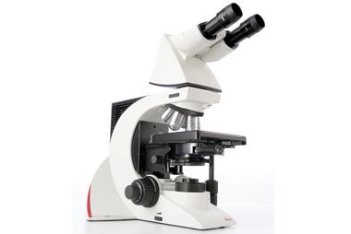
What do we need to see bacteria?
@EBSOClab #MicrobeToolkit
Notes:
4 stations at the back with slides of 4 different bacteria.

Slide 8
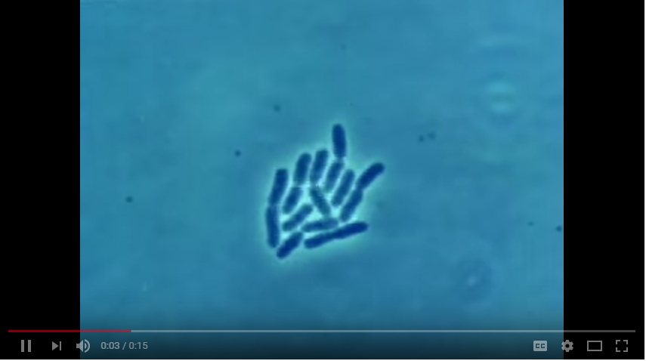
Here are some bacteria growing
Bacteria make more of themselves (reproduce) by splitting in half.
@EBSOClab #MicrobeToolkit
Notes:
Watch it and then watch it again at a slower speed.
E. Coli (Escherichia coli) is the name of a type of bacteria that lives in the digestive tracts of humans and animals.

Slide 9
We can grow bacteria on agar plates
A colony is big group of bacteria.
1 colony
@EBSOClab #MicrobeToolkit
Notes:
Ask them to describe the colonies.
Are they all the same? What are their similarities/ differences?
Can you count them?
The agar has food in it (sugar) for the bacteria to “eat”.

Slide 10
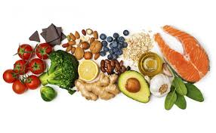
Where do we find bacteria?
Lots of places!
What do they need to grow?
@EBSOClab #MicrobeToolkit
Notes:
Evaluate knowledge using question prompts

Slide 11
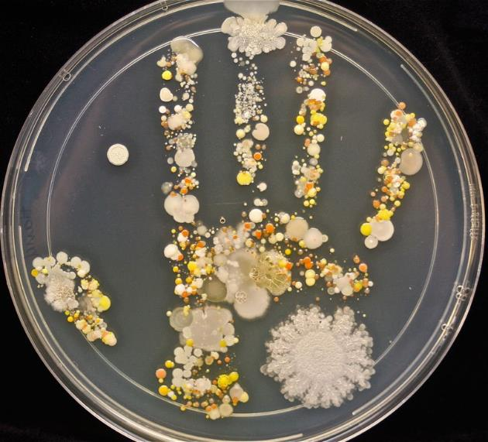
Are all bacteria bad?
@EBSOClab #MicrobeToolkit
Notes:
Answer: No! There are good and bad bacteria everywhere.
Look at this imprint of someone's hand, how many different types of bacteria do you think there are?

Slide 12
Today you are going to create your own experiment. To find out something about bacteria.
@EBSOClab #MicrobeToolkit

Slide 13
What do you want to find out?
Where are the most bacteria in/on ……?
Do bacteria grow on my desk?
Whose pencil has the most bacteria?
Which door handles have the most bacteria?
Do bacteria prefer wet or dry places?
What is the best way to wash my hands?
Do I really need to brush my teeth to keep them healthy?
@EBSOClab #MicrobeToolkit
Notes:
Question prompts. Give time to work in groups to create a question. (see teaching guide for more guidance)
Encourage to think about other questions. Remember a good science question is SMART:
S- specific- good investigations are about changing one thing to see what the effect is on another thing (dependent/independent variables)
M- measurable (how far something grows/moves, the time it takes for an animal/person to react/cross a line, the number of times) or observable (defining a pattern, comparing and contrasting)
A-Achievable- Can it be done in a reasonable time period? Do you have the materials to hand? Are they cheap enough to buy?
R- Relevant- Is the question subject age/curriculum relevant?
T - Testable- Is the experiment safe? Is the experiment ethical?

Slide 14
……………………………………………….
EXPERIMENTAL DESIGN
How are you going to do your experiment?
What do you need to do the experiment?
Is your experiment fair? What one thing are you changing?
AIM
What do you want to find out?
HYPOTHESIS
What do you think the result will be?
RESULTS
What did you see?
CONCLUSION
What did you find out? Was your hypothesis correct?
Plate section | Number of colonies
1
2
3
4
1
2
3
4
@EBSOClab #MicrobeToolkit
Notes:
Use the A3 sheets (1per group) to record their question and experiment.

Slide 15
Write your question to make a display!
@EBSOClab #MicrobeToolkit
Notes:
Student can write their question on the hand-out to make a display.
Printed- with resource pack.

Slide 16
Example: We want you to find out which location has the most bacteria!
AIM
What do we want to find out?
@EBSOClab #MicrobeToolkit

Slide 17
EXPERIMENTAL DESIGN
How did you do the experiment?
What do you need to do the experiment?
Is the experiment fair? What one thing are you changing?
AIM
What do we want to find out?
HYPOTHESIS
What do you think the result will be?
RESULTS
What did you see?
CONCLUSION
What did you find out? Was your hypothesis correct?
Plate section | Number of colonies
1
2
3
4
@EBSOClab #MicrobeToolkit
Notes:
Students write what their aim is.

Slide 18
We think that ……
HYPOTHESIS
What do you think the result will be?
@EBSOClab #MicrobeToolkit

Slide 19
EXPERIMENTAL DESIGN
How did you do the experiment?
What do you need to do the experiment?
Is the experiment fair? What one thing are you changing?
AIM
What do we want to find out?
HYPOTHESIS
What do you think the result will be?
RESULTS
What did you see?
CONCLUSION
What did you find out? Was your hypothesis correct?
Plate section | Number of colonies
1
2
3
4
@EBSOClab #MicrobeToolkit
Notes:
Students write what their hypothesis is.

Slide 20
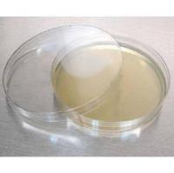
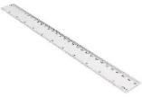
This is what you will do and how…
EXPERIMENTAL DESIGN
You will need…
1 agar plate
4 swabs
1 pen and ruler
@EBSOClab #MicrobeToolkit

Slide 21
EXPERIMENTAL DESIGN
How did you do the experiment?
What do you need to do the experiment?
Is the experiment fair? What one thing are you changing?
AIM
What do we want to find out?
HYPOTHESIS
What do you think the result will be?
RESULTS
What did you see?
CONCLUSION
What did you find out? Was your hypothesis correct?
Plate section | Number of colonies
1
2
3
4
@EBSOClab #MicrobeToolkit
Notes:
Students write how they will do their experiment (they will swab up to 4 locations/ surfaces- they should number each one 1 to 4

Slide 22
Stop and think!
What are your going to swab?
Is the experiment fair?
Does repeating the experiment make it better?
@EBSOClab #MicrobeToolkit

Slide 23
Before we give you the materials………..
When performing experiments, safety is very important!!
DO NOT EAT OR DRINK
WORK CAREFULLY WITH THE EQUIPMENT
LISTEN AND FOLLOW THE INSTRUCTIONS
WASH YOUR HANDS AT THE END
@EBSOClab #MicrobeToolkit

Slide 24
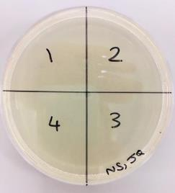
This is what you will do…
1) Set up your plate
Draw on the bottom (the side the agar is in) of your plate:
Don’t open it!! Why?
Write on your group letter and your initials.
@EBSOClab #MicrobeToolkit
Notes:
Run through the procedure

Slide 25
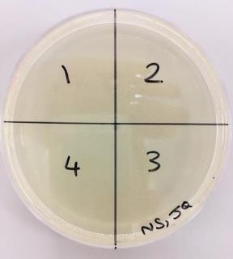
2) Swab the location and the plate
Swab the location with the swab and then squiggle lightly the swab over the agar in the correct quarter of the plate:
Have you written each location in your “Experimental Design” and given it a number?
@EBSOClab #MicrobeToolkit

Slide 26
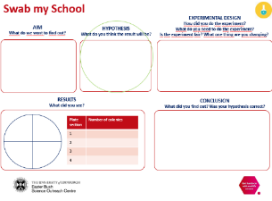
Gather your equipment (per group)
1 agar plates
4 Swabs
1 pen and ruler
Don’t open it until you are ready to swab!! Why?
1 worksheet
@EBSOClab #MicrobeToolkit
Notes:
After checking the question and where they are going to swab, hand out the material.
Students swab.

Slide 27
Lets’ do it!
1) Set up your plate
Draw on the bottom (the side the agar is in) of your plate:
Don’t open it!! Why?
Write on your group letter and your initials.
@EBSOClab #MicrobeToolkit
Notes:
Run through the procedure

Slide 28
2) Swab the location and the plate
Swab the location with the swab and then squiggle lightly the swab over the agar in the correct quarter of the plate:
Have you written each location in your “Experimental Design” and given it a number?
@EBSOClab #MicrobeToolkit

Slide 29
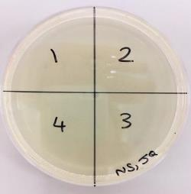
3) Tape the plate
Use two small strips of tape to close the plate permanently.
DO NOT SEAL AROUND THE PLATE AS IT CAN CAUSE THE GROWTH OF DANGEROUS BACTERIA.
The plate must NEVER be reopened, even if it looks as if nothing is growing on it.
@EBSOClab #MicrobeToolkit

Slide 30
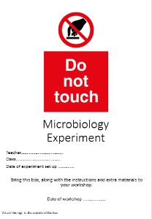
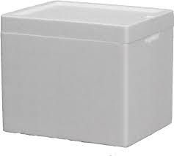
4) Store the plates
Place all the plates into the box, stick the biohazard sign outside the box and leave them in a safe place, in the shade, at room temperature.
Bring ALL plates, your worksheets, the pens and tape to your teacher to store.
@EBSOClab #MicrobeToolkit
Notes:
Please note that the lead GSS teacher will be responsible for storing all the plates in a single box.
Count all the plates back into the box, to ensure you have them all.

Slide 31
Now wash your hands with soap and hot water
@EBSOClab #MicrobeToolkit

Slide 32
We will look at your results in a few days!
@EBSOClab #MicrobeToolkit

Slide 33
What did you see?
EXPERIMENTAL DESIGN
How did you do the experiment?
What do you need to do the experiment?
Is the experiment fair? What one thing are you changing?
AIM
What do we want to find out?
HYPOTHESIS
What do you think the result will be?
RESULTS
What did you see?
CONCLUSION
What did you find out? Was your hypothesis correct?
Plate section | Number of colonies
1
2
3
4
@EBSOClab #MicrobeToolkit
Notes:
There are different ways that their results could be recorded, here are some question prompts:
Can you count the number of colonies?
Can you count how many different colonies there are?
Can you take a picture or draw what you see?
Can you compare what you see in each section?

Slide 34
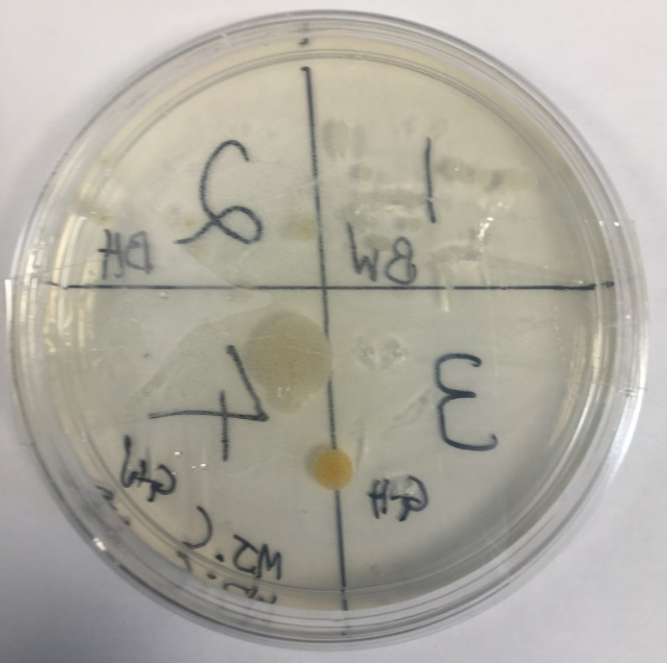
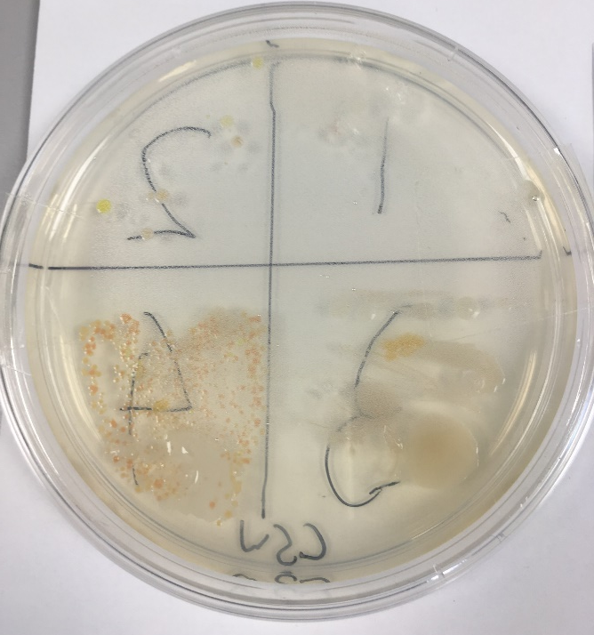
5) Hand out the plates*
The plate must NEVER be opened, even if it looks as if nothing is growing on it!
* If you are working with pupils <P5 only adults should handle the plates.
Ideas to record your results:
Take a photo
Draw your plate
Write a description
Count the colonies
Count the different colours of colonies
Estimate the area the bacteria has grown on
@EBSOClab #MicrobeToolkit
Notes:
Plates must NEVER be opened, ensure that the tape is secure.
Do not let younger learners (less than P5) handle the plates, incase they drop the plate.
The bacteria growing on the plates are a potential hazard. Please note that the lead GSS teacher will be responsible for storing all the plates in a single box.
Count all the plates back into the box, to ensure you have them all.
Store the plates back in the box when each group is finished.

Slide 35
6) Return the plates*
Bring ALL plates back to your teacher to store
* If you are working with pupils <P5 only adults should handle the plates.
@EBSOClab #MicrobeToolkit
Notes:
Plates must NEVER be opened, ensure that the tape is secure.
Do not let younger learners (less than P5) handle the plates, incase they drop the plate.
The bacteria growing on the plates are a potential hazard. Please note that the lead GSS teacher will be responsible for storing all the plates in a single box.
Count all the plates back into the box, to ensure you have them all.
Store the plates back in the box when each group is finished.

Slide 36
Now wash your hands with soap and hot water
@EBSOClab #MicrobeToolkit

Slide 37
What did you see?
EXPERIMENTAL DESIGN
How did you do the experiment?
What do you need to do the experiment?
Is the experiment fair? What one thing are you changing?
AIM
What do we want to find out?
HYPOTHESIS
What do you think the result will be?
RESULTS
What did you see?
CONCLUSION
What did you find out? Was your hypothesis correct?
Plate section | Number of colonies
1
2
3
4
@EBSOClab #MicrobeToolkit
Notes:
Encourage pupils to sum up what they have found out, is their hypothesis correct?
What could they do next?
If they repeated the experiment what would they like to change?

Slide 38
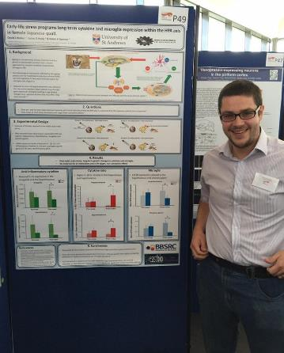
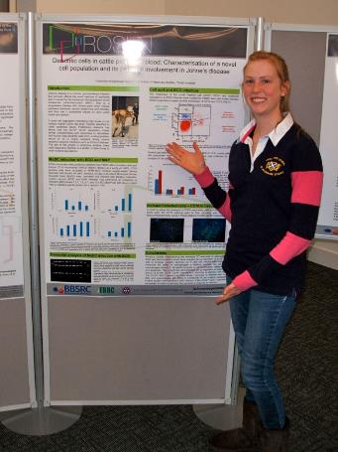
Share your science!
Scientists share their science all the time using posters and by giving presentations.
@EBSOClab #MicrobeToolkit

Slide 39
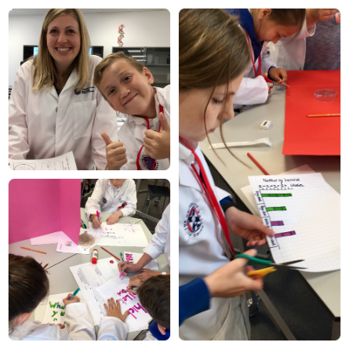
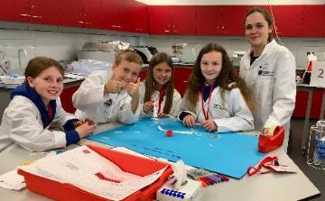
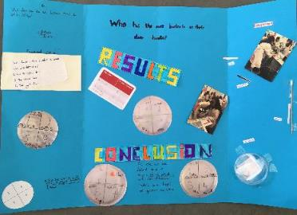
Share your science!
Here is some inspiration for you to create your own posters
@EBSOClab #MicrobeToolkit

Slide 40
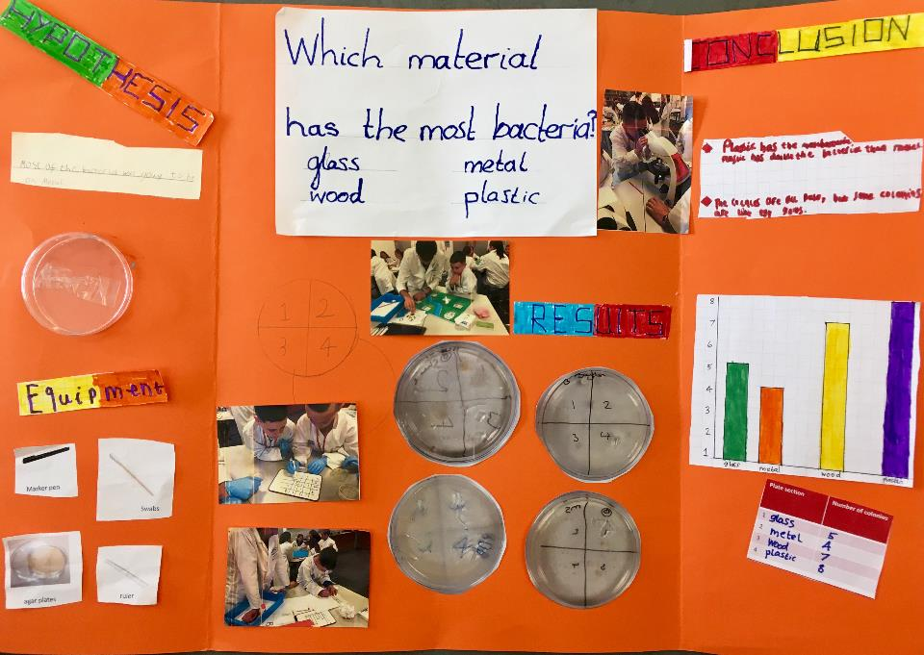

Slide 41
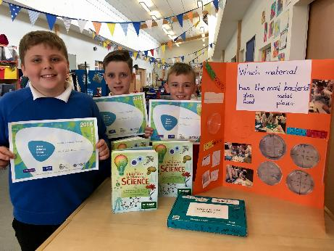
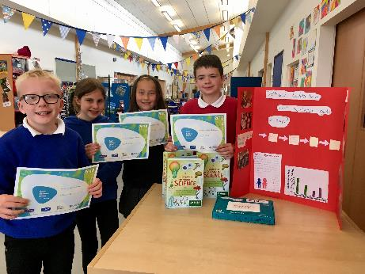
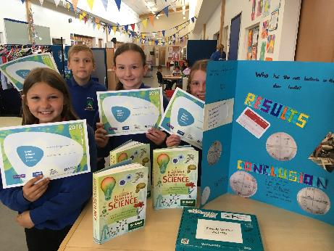
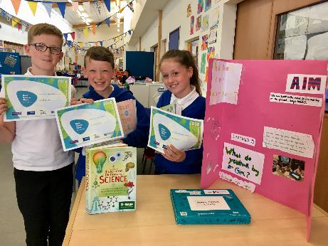
Notes:
Students create their own posters.

Slide 42
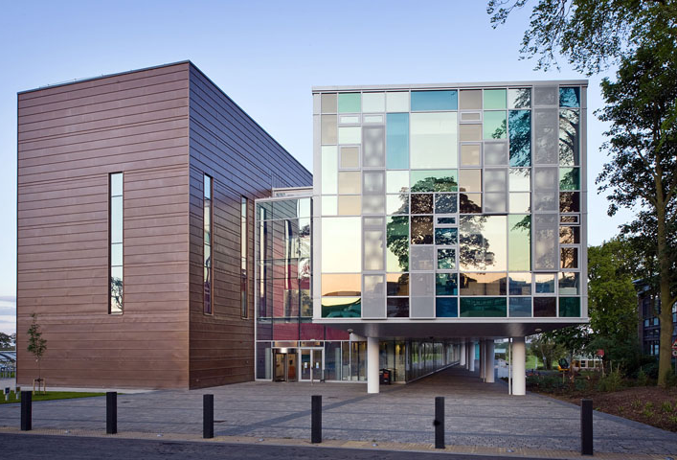
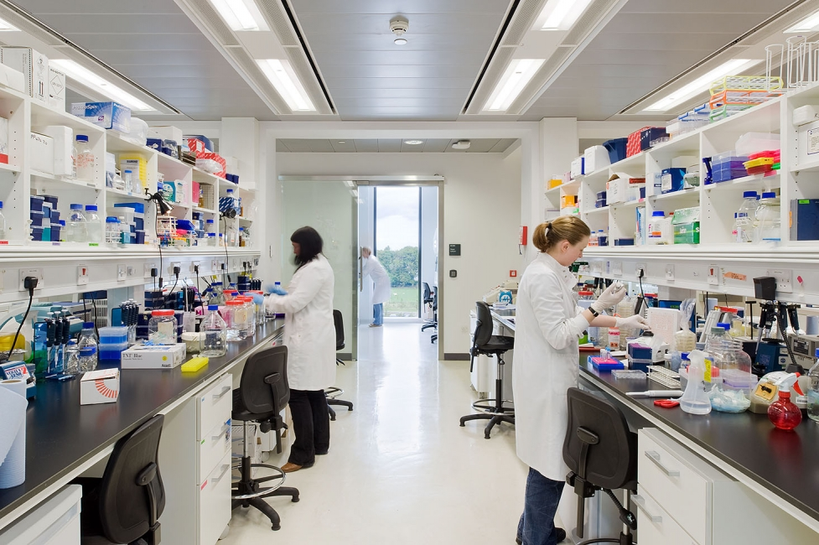
What does The Roslin Institute do?
The Roslin Institute aims to make the lives of animals and humans better by studying animal biology.
The Roslin Institute Building
Inside one of the labs
One of the ways they do this is by studying infectious diseases of farm animals.
@EBSOClab #MicrobeToolkit

Slide 43
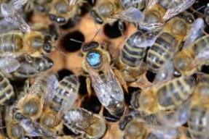
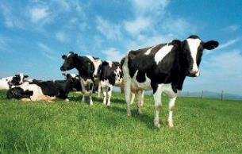
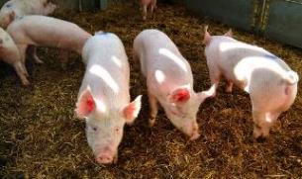
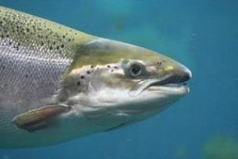
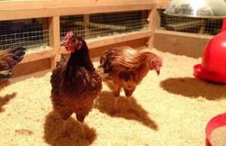
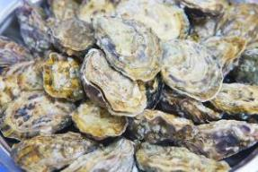
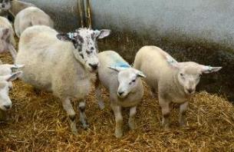
How does it do this?
Traditional farm animals
Non-traditional farm animals
One of the ways they do this is by studying infectious diseases that make farmed animals sick.
@EBSOClab #MicrobeToolkit
Notes:
Non- traditional farm animals: bees, salmon and oysters!

Slide 44
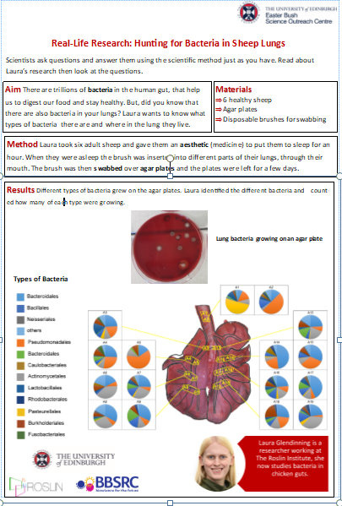
Real-Life Research: Hunting for Bacteria in Sheep Lungs
Scientists ask questions and answer them using the scientific method just as you have. Read about Laura’s research then look at the questions.
Aim There are trillions of bacteria in the human gut, that help us to digest our food and stay healthy. But, did you know that there are also bacteria in your lungs? Laura wants to know what types of bacteria there are and where in the lung they live.
Materials
6 healthy sheep
Agar plates
Disposable brushes for swabbing
Collect a worksheet
Method Laura took six adult sheep and gave them an aesthetic (medicine) to put them to sleep for an hour. When they were asleep the brush was inserted into different parts of their lungs, through their mouth. The brush was then swabbed over agar plates and the plates were left for a few days.
@EBSOClab #MicrobeToolkit

Slide 45
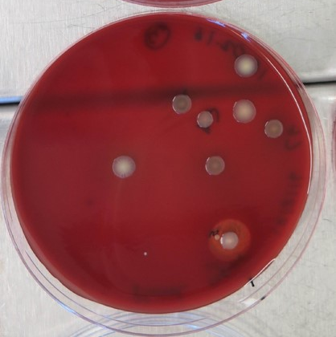
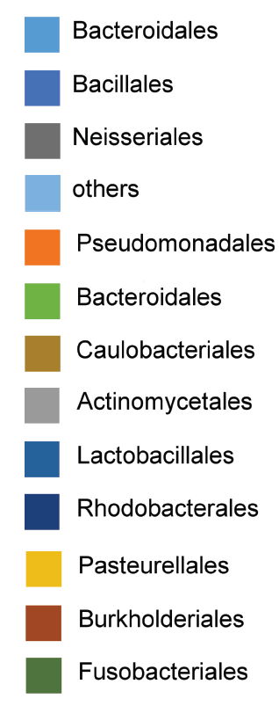
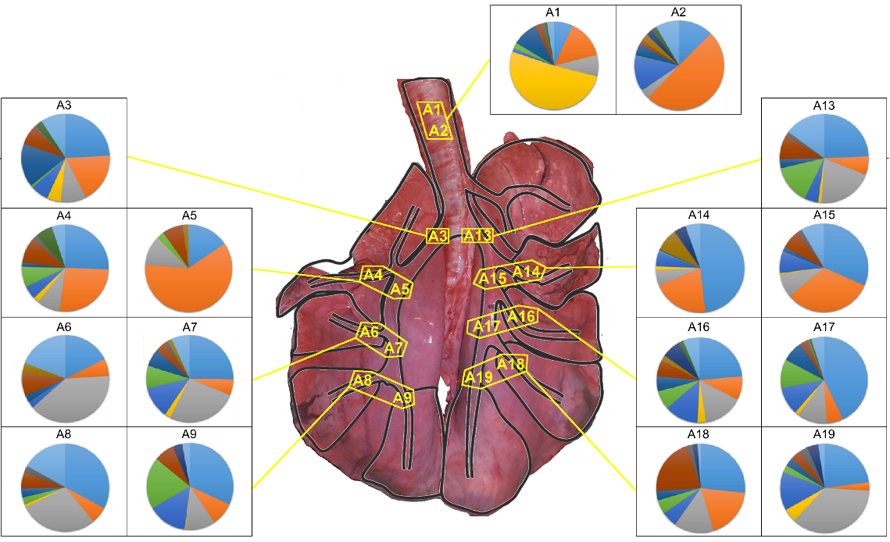
Results Different types of bacteria grew on the agar plates. Laura identified the different bacteria and counted how many of each type were growing.
Lung bacteria growing on an agar plate
Types of Bacteria
@EBSOClab #MicrobeToolkit

Slide 46
Think & Discuss
1) What did Laura use to collect the bacteria? What else could she use?
2) Why were the sheep put to sleep using an anaesthetic?
3) Why did Laura study more than one sheep ?
4) Why did Laura only look at healthy sheep?
5) Look at the results section. Answer true or false to the following statements and correct the false ones:
6) Laura’s conclusion is: There are lots of different types of bacteria in different places in sheep lungs. Do you agree with her conclusion? Why/why not?
A) Laura did not find any bacteria in the sheep lungs. | ………………………………………………..
B) Laura looked for bacteria in 19 different places in the sheep lungs. | ………………………………………………..
C) Laura used bar charts to show her results. | ………………………………………………..
D) These sheep must all be sick as they have bacteria in their lungs. | ………………………………………………..
@EBSOClab #MicrobeToolkit

Slide 47
Tweet us your science investigations @EBSOClab @GreatSciShare #MicrobeToolkit
Copyright © 2019 All rights reserved by The University of Edinburgh.
This resource has been developed by the Easter Bush Science Outreach Centre.

