Slide 2
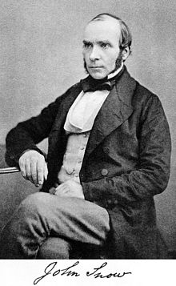
What is epidemiology?
Epidemiology is the study of patterns in health and disease in a population…

Slide 3
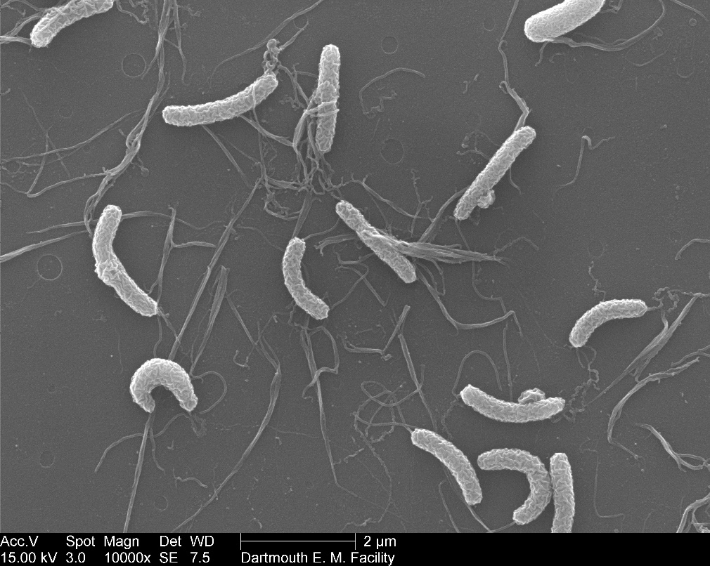
What is epidemiology?
Source: Dartmouth EM Facility (https://bit.ly/2J5w97h)
Source: The Guardian (https://bit.ly/2RO7iaA)

Slide 4
About me
INSERT 1 OR 2 SLIDES ABOUT YOUR WORK AND YOUR BACKGROUND HERE

Slide 5
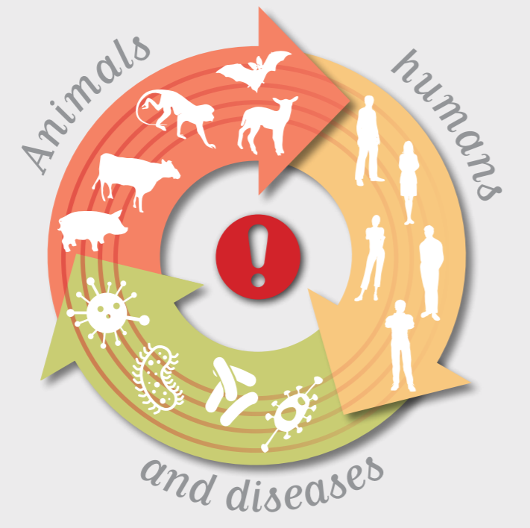
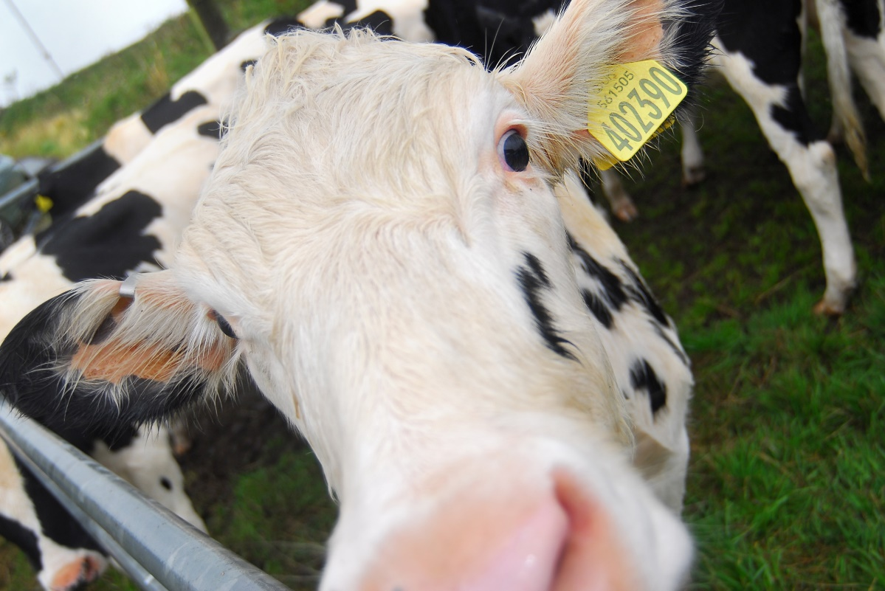
Why does it matter? One health!
Human and animal health depend on eachother
Animal disease can put our food security at risk
Source: World Organization for Animal Health (https://bit.ly/2XLpXJz)

Slide 6
How do we answer scientific questions?
Do an experiment!!

Slide 7
Then we use the scientific method to answer it:
MATERIALS
What do you need to do your investigation?
METHOD
How are you going to do your investigation? What ONE thing are you changing? What are you going to measure/observe?
RESULTS
What did you see? Can you measure it? Can you make a table or a graph of your results?
CONCLUSION
What did you find out? Was your hypothesis correct? If not, why do you think this is?
HYPOTHESIS
What do you think the result will be?
QUESTION
What do you want to find out?
REFLECTION
If you could repeat this investigation is there anything you would change? If you could do another investigation what would your question be?
Word bank:
Materials
Results
Reflection
Conclusion
Method
Hypothesis

Slide 8
It’s your turn!!

Slide 9
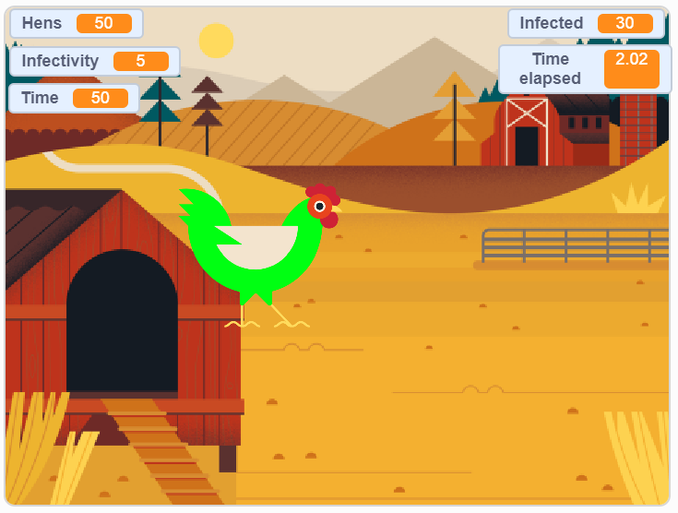
You can change:
Click me
Number of hens on the farm
You can measure:
How likely hens are to spread the disease (1-10)
Number of infected hens
The time hens are kept in contact (seconds)
Time taken for all hens to be infected (seconds)

Slide 10
Question: Does how infective the disease is affect how far it spreads?
CHANGE THIS AS APPROPRIATE
Your hypothesis is what you think might happen at the end of the experiment
Your independent variable is the one that you change
Your dependent variable is the one that you measure
Your controls are the variables that you keep the same
Notes:
CHECKPOINT – Make sure all pupils have successfully defined their variables before moving on.

Slide 11
Go!

Slide 12
Graph your results

Slide 13
What did you discover?

Slide 14
Thank you!

