Slide 1
Notes:
EBSOC, based in Midlothian and Easter Bush has is a science lab for kids to do real- science. They have sent us a science kits so that we can do some real science here in our classroom as part of the Great Science Share!

Slide 2
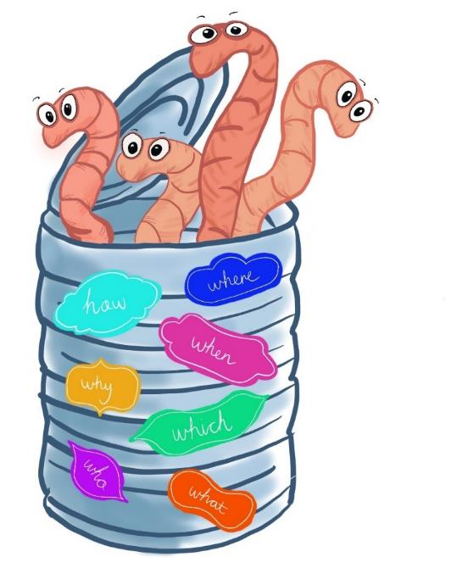
Animal Behaviour Toolkit

Slide 3
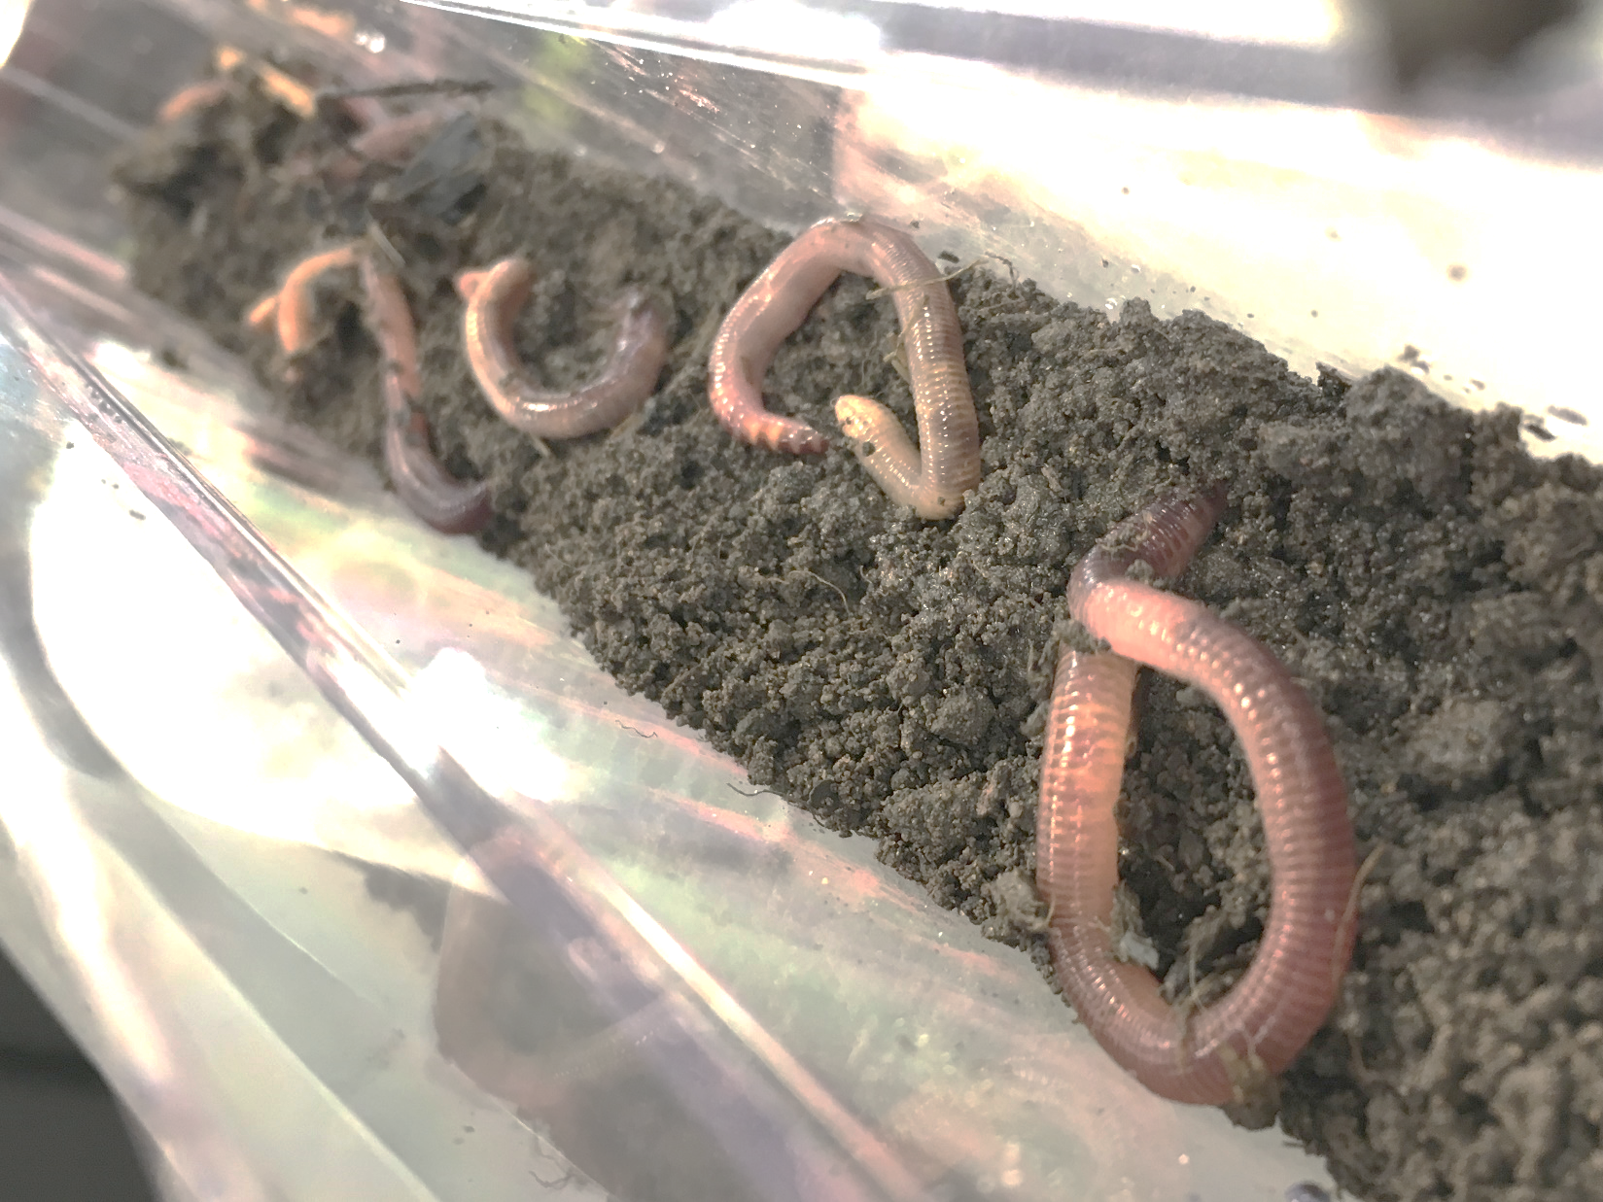
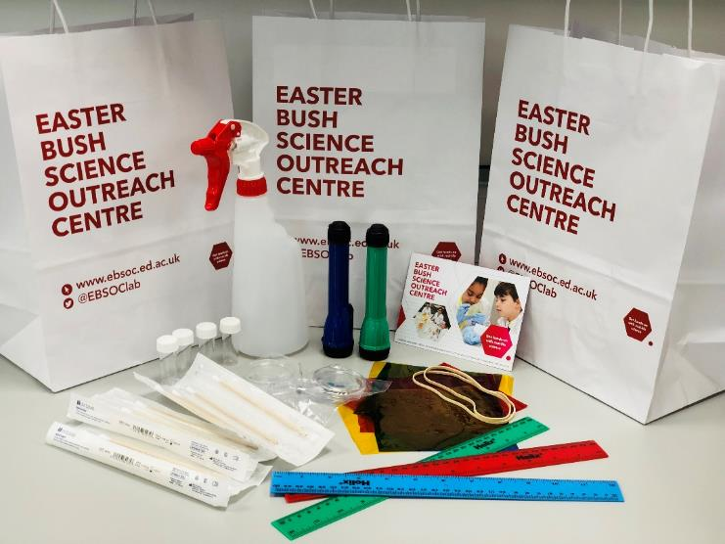
What are we going to do?
Using a science kit that you have been sent from the Easter Bush Science Outreach Centre, you are going to design and do an experiment.
What do you want to know about earthworms?
@EBSOClab #BehaviourToolkit
Notes:
Introduction to what they are going to do.

Slide 4
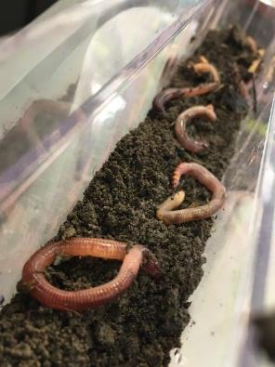
What are earthworms?
Earthworms are:
Animals
Invertebrates (no backbones)
Cold-blooded
Earthworms are very important because they make soil (they are decomposers)
@EBSOClab #BehaviourToolkit
Notes:
Pupils brainstorm- write words on the board.
See EARTHWORM FACT FILE for more information about earthworms

Slide 5
Let’s observe some earthworms
Aim: Use your observation skills to draw an earthworm
Materials:
Earthworms
Water spray
Tray or plate
Soil
Magnifying glass
Worm Welfare
Earthworms need to keep their skin damp so that they can breathe, they also prefer dark places and do not like to be handled. Worms should not be out of their home for more than 20 minutes.
Method:
1. Carefully place your worm on a surface with some damp soil, the soil and worm should be kept moist using the spray.
2. Observe the shape and structure of the worm, look at how it moves.
3. Draw the worm, try to add as much detail as you can.
4. Label your diagram, where is its head, where is its tail? Can you see any other body parts?
@EBSOClab #BehaviourToolkit
Notes:
4 stations at the back with slides of 4 different bacteria.

Slide 6
Today you are going to create your own experiment. To find out something about earthworms.
@EBSOClab #BehaviourToolkit

Slide 7
Here is an example of how we investigate in science!
@EBSOClab #BehaviourToolkit
Notes:
Play the movie on the next slide and pause in places if required.

Slide 8
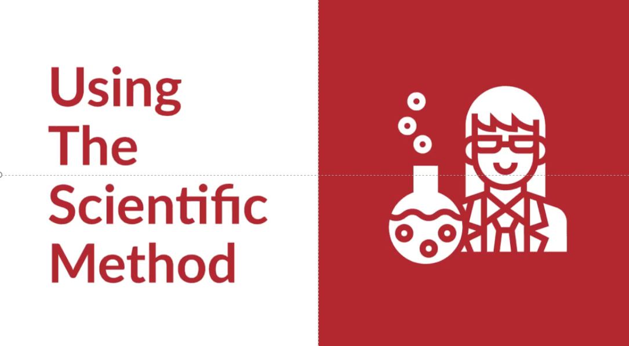
Scientific Method Video
Click picture to open link to video
@EBSOClab #BehaviourToolkit

Slide 9
What do you want to find out?
How long is a worm?
Do worms react to coloured light?
Do worms prefer light or dark?
Where are worms most sensitive to touch?
Which types of food do worms prefer?
Do worms have a sense of smell ?
Or something else…….?
@EBSOClab #BehaviourToolkit
Notes:
Question prompts. Give time to work in groups to create a question. (see teaching guide WHAT QUESTIONS CAN BY PUPILS ASK for more guidance)
Encourage to think about other questions. Remember a good science question is SMART:
S- specific- good investigations are about changing one thing to see what the effect is on another thing (dependent/independent variables)
M- measurable (how far something grows/moves, the time it takes for an animal/person to react/cross a line, the number of times) or observable (defining a pattern, comparing and contrasting)
A-Achievable- Can it be done in a reasonable time period? Do you have the materials to hand? Are they cheap enough to buy?
R- Relevant- Is the question subject age/curriculum relevant?
T - Testable- Is the experiment safe? Is the experiment ethical?

Slide 10
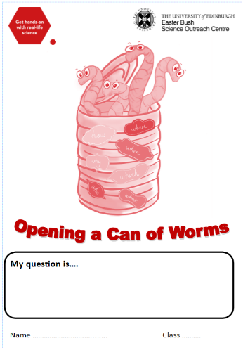
Now plan your experiment!
Complete these sections then check your progress with your teacher:
Question
Aim
Hypothesis
Materials
Method
Teacher Checkpoint

Slide 11
Before we work with animals in science we have to think about their welfare.
@EBSOClab #BehaviourToolkit
Notes:
NOTE: pupils in P5 and above should work through this in their groups and should be checked before the groups are given the worms.
Younger pupils, who will be working on question as a group should ensure their teacher has applied the 3Rs.

Slide 12
Worm Welfare: Have you checked the 3Rs?
Replace Reduce Refine
The 3Rs are how we make sure animals in experiments are properly taken care of and protected from unnecessary suffering.
Before scientists can get a licence to do animal research, they always have to show that they have applied the 3Rs.
Check the 3Rs for your experiment.
@EBSOClab #BehaviourToolkit
Notes:
NOTE: pupils in P5 and above should work through this in their groups and should be checked before the groups are given the worms.
Younger pupils, who will be working on question as a group should ensure their teacher has applied the 3Rs.

Slide 13
Replace
This means using something else to do the experiment if you can and is the most important of the 3Rs. It is always better to avoid using animals if that is possible.
Can your experiment be done in another way without using an animal?
Yes £
No £
@EBSOClab #BehaviourToolkit
Notes:
No, this experiment requires us to use earthworms.

Slide 14
Reduce
We should always use the fewest number of animals possible in any experiment. Fewer animals means there is less chance of causing harm.
Can you use fewer animals?
Yes £
No £
@EBSOClab #BehaviourToolkit
Notes:
Use no more worms than required, three is a good number to calculate averages.

Slide 15
Refine
This is the most complex of the 3Rs. It means trying to think about the experience of the animal and designing experiments and housing to make their experience better. We should always do everything possible to reduce pain, discomfort or distress.
Using an animal that has a simpler nervous system and brain (like a worm) can be a refinement, because we think those animals experience less stress.
Can you use a simpler organism to do your research?
Yes £
No £
@EBSOClab #BehaviourToolkit
Notes:
No, a worm is one of the simplest animals we can use.

Slide 16
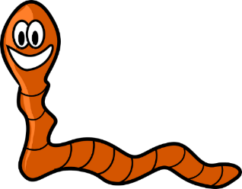
Can you change your experiment in any way to make it less stressful for the animals?
Perhaps by handling them for less time, or working in a more comfortable and familiar environment? If yes, how?
Yes £
No £
I like dark places and living in soil.
I don’t like having dry skin, if my skin is dry I can’t breathe. I don’t like being handled too much.
@EBSOClab #BehaviourToolkit
Notes:
Worms should be handled for less than 20 minutes, turn of the lights in the classroom to make it dimmer, place them on damp soil and keep them damp so they can breathe! Use the waterspray to keep your worm damp.

Slide 17
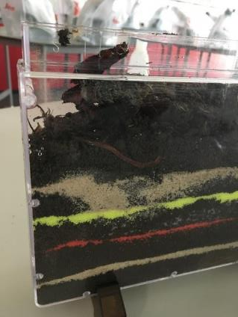
Do you understand what your animal needs to feel comfortable and can you improve their living conditions to make them more like what the animal would choose for itself? If yes, how?
Yes £
No £
@EBSOClab #BehaviourToolkit
Notes:
Teachers should discuss this with their pupils, see the teachers guide to understand how to look after the worms, and how to handle them.

Slide 18
Well done, you have all thought about the welfare of the worms.
@EBSOClab #BehaviourToolkit
Notes:
NOTE: pupils work in their assigned groups ot do their experiment,

Slide 19
Before we give you your materials………..
When performing experiments, safety is very important!!
DO NOT EAT OR DRINK
WORK CAREFULLY WITH THE WORMS
LISTEN AND FOLLOW THE INSTRUCTIONS
WASH YOUR HANDS AT THE END
@EBSOClab #BehaviourToolkit

Slide 20
Collect your materials and carry out your investigation! Remember to record your results What will you record?
@EBSOClab #BehaviourToolkit
Notes:
NOTE: pupils work in their assigned groups to do their experiment, but ensure each group know what they are going to record:
For example: time, distance, movement towards a stimulus, taking photos, a movie, a word description

Slide 21
Now wash your hands with soap and hot water
@EBSOClab #BehaviourToolkit

Slide 22
Now complete your experiment booklet!
Complete these sections then check your progress with your teacher:
Results
Conclusion
Teacher Checkpoint
Notes:
Pupils fill in their booklet (1 per group) or write their results on paper.

Slide 23
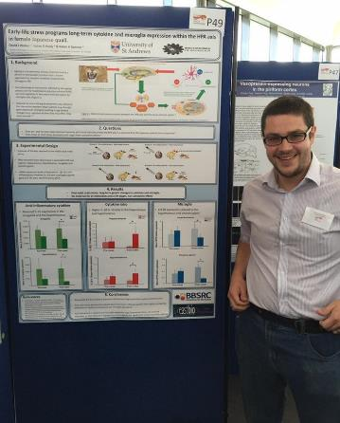
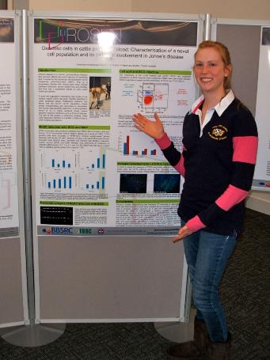
Share your science!
Scientists share their science all the time using posters and by giving presentations.
@EBSOClab #BehaviourToolkit

Slide 24
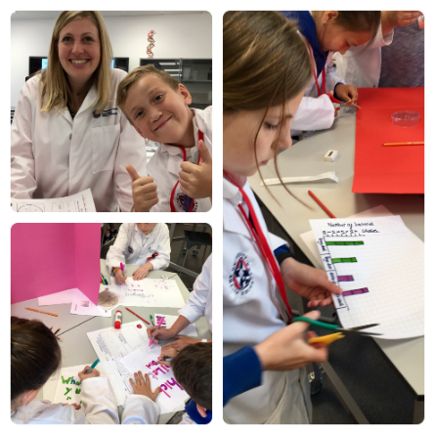
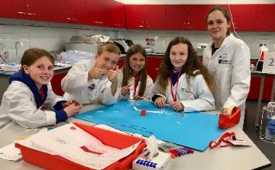
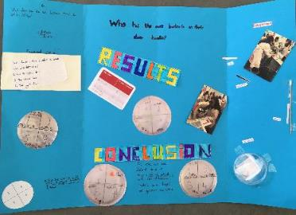
Share your science!
Here is some inspiration for you to create your own posters
@EBSOClab #BehaviourToolkit

Slide 25
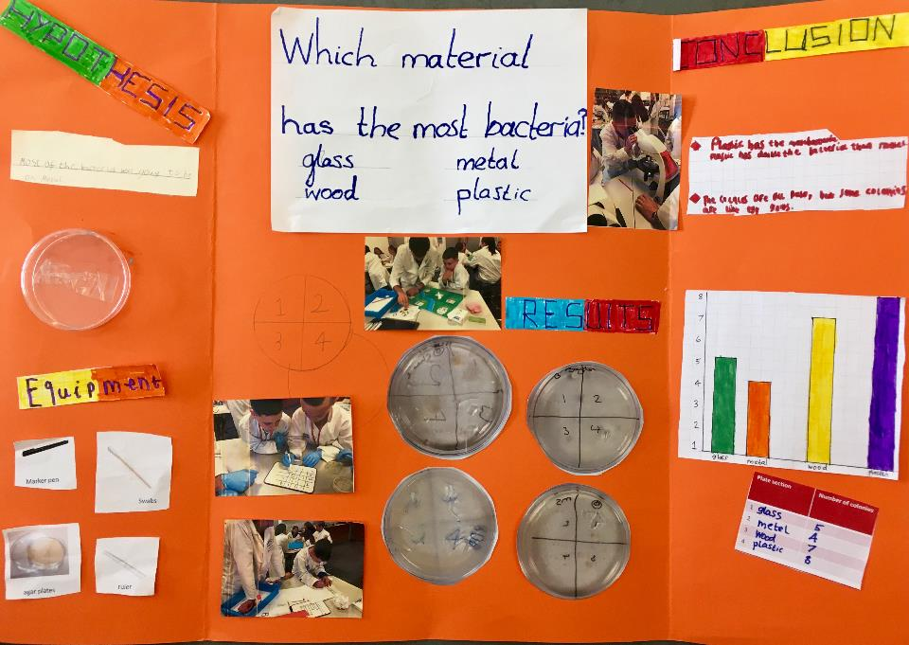
@EBSOClab #BehaviourToolkit

Slide 26
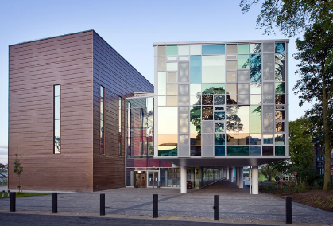
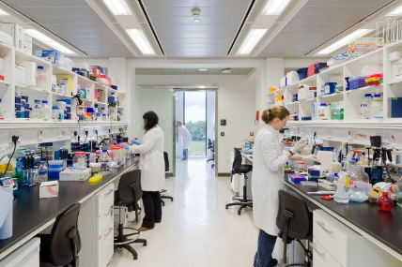
What does The Roslin Institute do?
The Roslin Institute aims to make the lives of animals and humans better by studying animal biology.
The Roslin Institute Building
Inside one of the labs
One of the ways they do this is by studying and understanding animal behaviour.
@EBSOClab #BehaviourToolkit

Slide 27
Real-Life Research: Do Rats Like Being Tickled?
Scientists ask questions and answer them using the scientific method just like you have. Read about Tayla’s research then look at the questions.
Tayla Hammond is the scientist that did this scientific investigation. She says “I love the variety in science, yesterday rat tickling, today observing behaviour!”
Aim Rats make ultrasonic (very high pitched) noises when they are happy! Observing when rats make these noises tells scientists what rats like and don’t like. Tayla wants to know if rats like to be tickled.
Materials
24 rats (12 pairs)
Cotton glove
Night vision camera
Ultrasonic sound recorder
Tayla Hammond is a PhD student studying at SRUC & The Roslin Institute
@EBSOClab #BehaviourToolkit

Slide 28
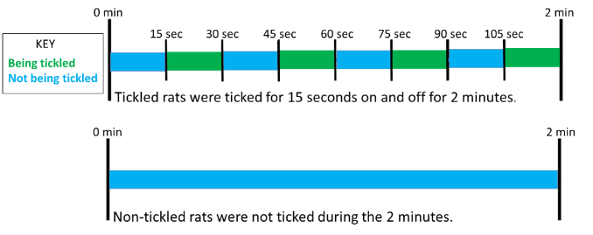
Method Tayla took 24 male rats, and chose half of them at random to be tickled. The other half were not ticked.
Each rat was then moved to the handling arena and tickled or not tickled for 2 minutes.
Any ultrasonic noises were recorded during the 2 minutes of the experiment.

Slide 29
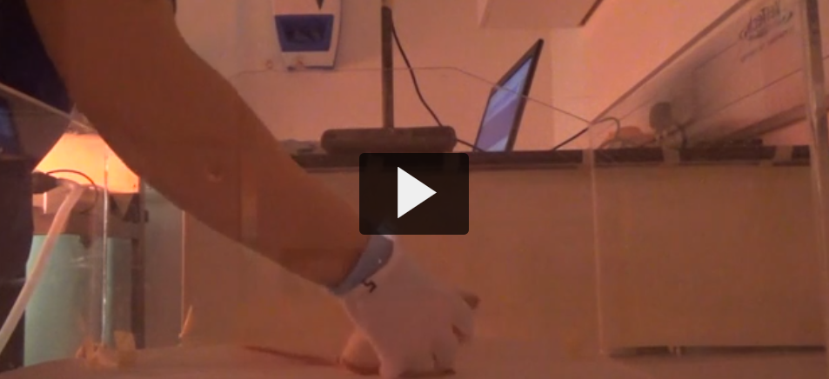
Watch Tayla tickle a rat!

Slide 30
What did she find out?
Results During the tickle test the tickled rats made 3x more ultrasonic noises than the non-tickled rats.
Conclusion Rats like to be tickled. Tayla also observed that the rats looked forward to tickling!

Slide 31
Think & Discuss
What activities do you think rats do that make them happy?
2) Why do you think Tayla kept the rats in pairs in their cages?
3) What part of the scientific method is missing? Can you write it?
4) How many rats were tickled?
5) Why did Tayla only tickle half of the rats?
6) Why do you think it is important to understand positive emotions, like happiness, in animals?
@EBSOClab #BehaviourToolkit

Slide 32
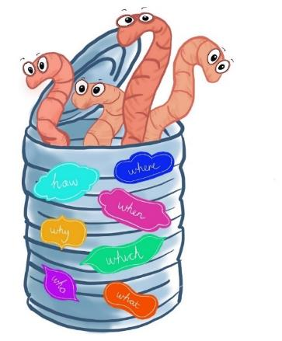
Tweet us your science investigations @EBSOClab #BehaviourToolkit
Copyright © 2019 All rights reserved by The University of Edinburgh.
This resource has been developed by the Easter Bush Science Outreach Centre.

